Slide 1
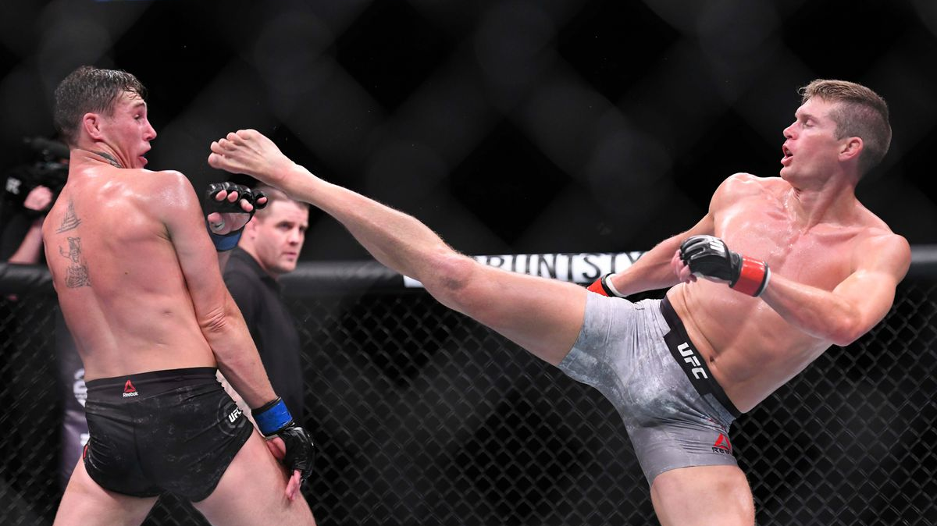
MMA Strike Analysis using computer vision
GA Dsi 25 – Haziq

Slide 2
Overview
Background
Problem Statement
Data Preprocessing
EDA
Modelling
Future Improvements
Conclusion

Slide 3
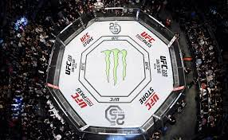

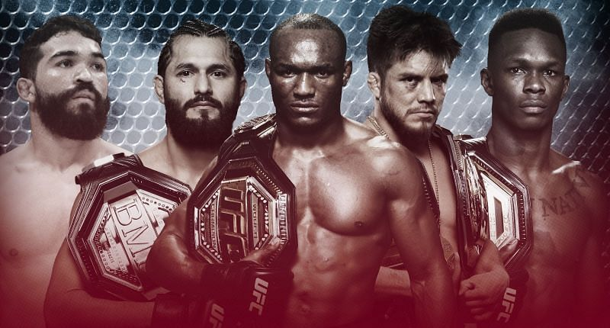

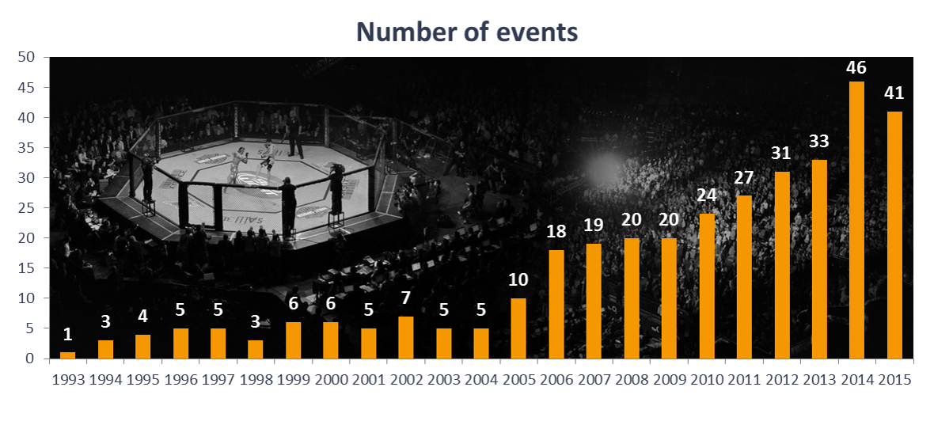
UFC: USD 7 billion
ONE Championship: USD 1 billion
Notes:
- MMA is one of the fastest growing sport in the world, pushed primiarily by the rapid growth of the UFC
Worth in the range of 7-9 billion dollars
Closer to home, One Championship is gaining traction fast.
With the increasing number of fighters around the world both amateur and pros, motivation is to create a computer vision tool that can assist judges in scoring fights.
One of the first few sports to open up amidst the pandemic

Slide 4
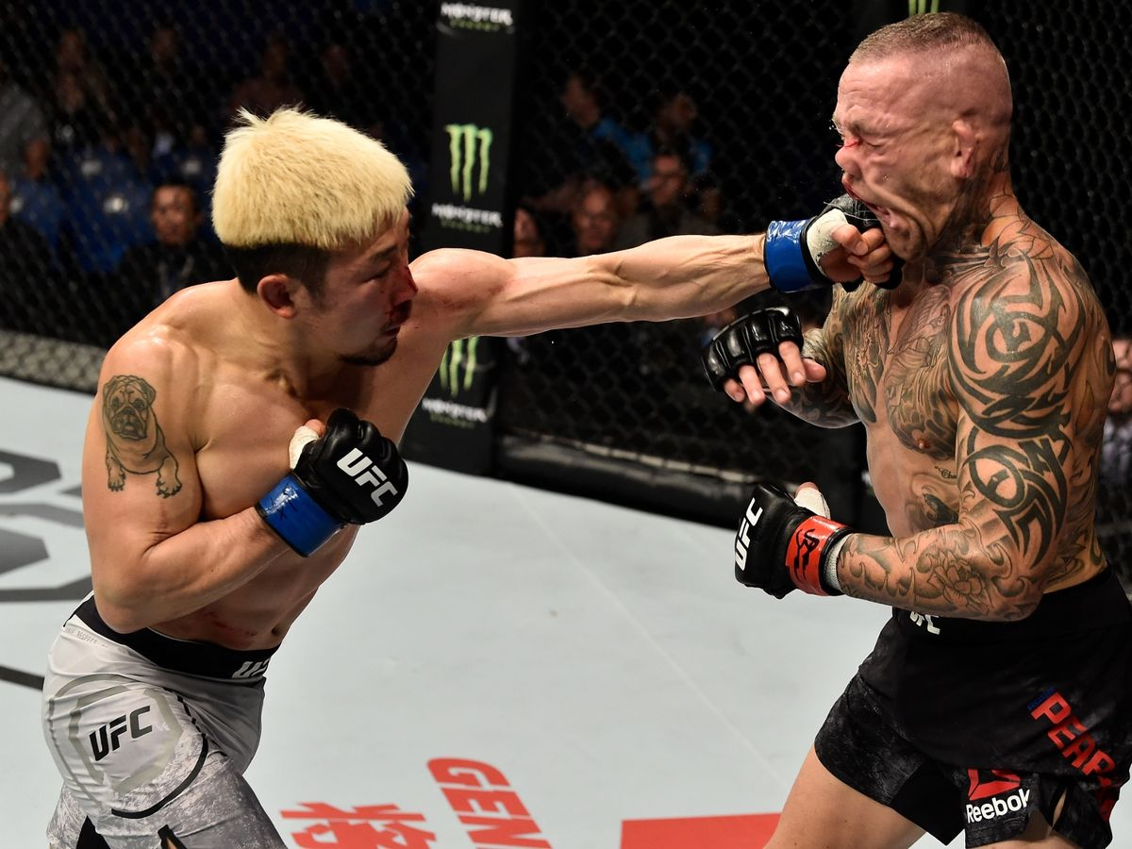
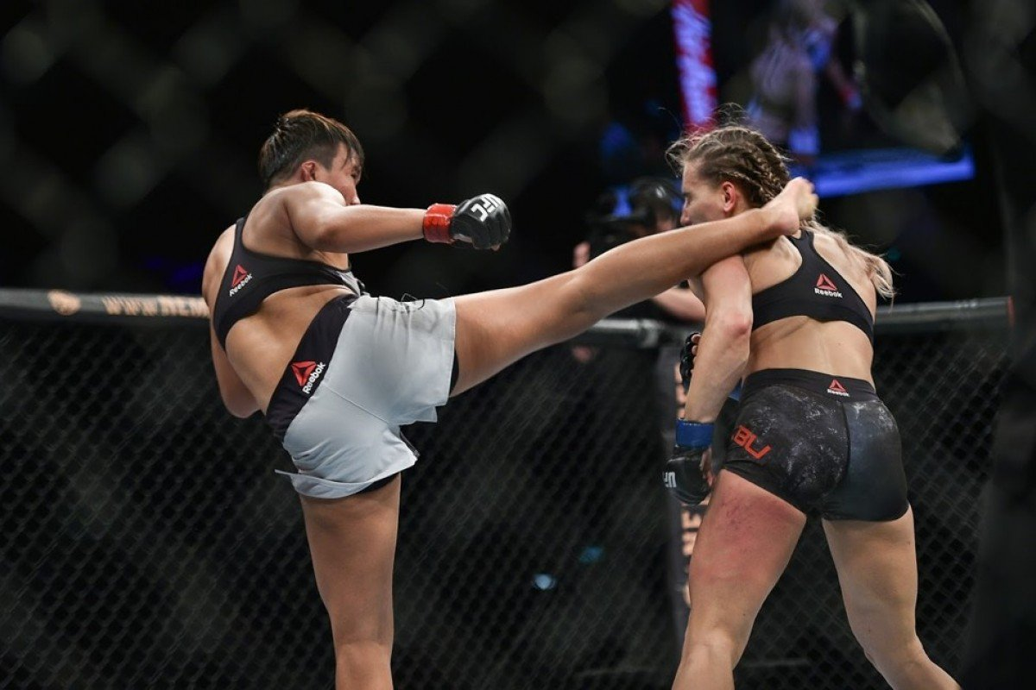
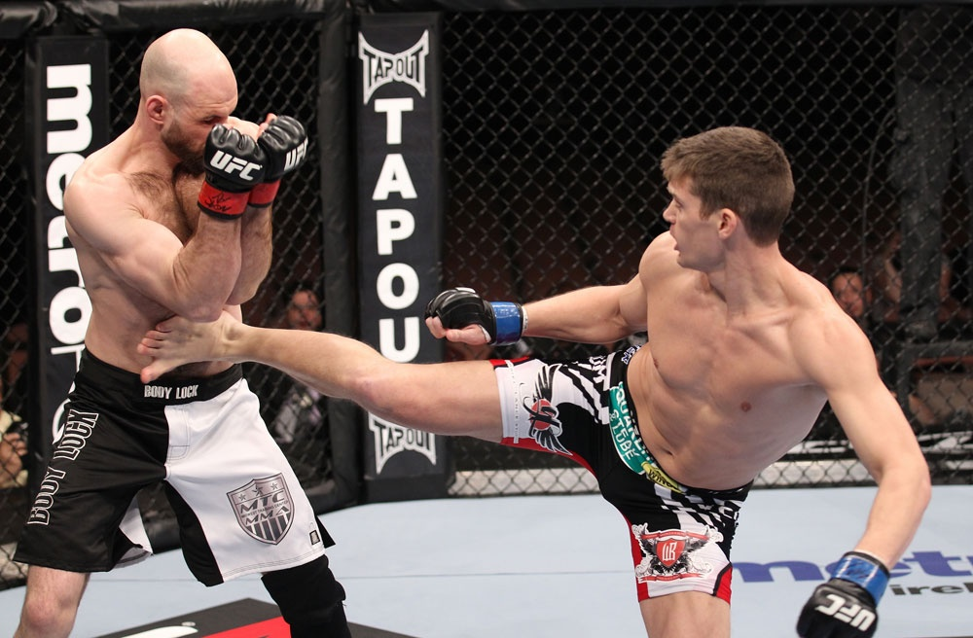
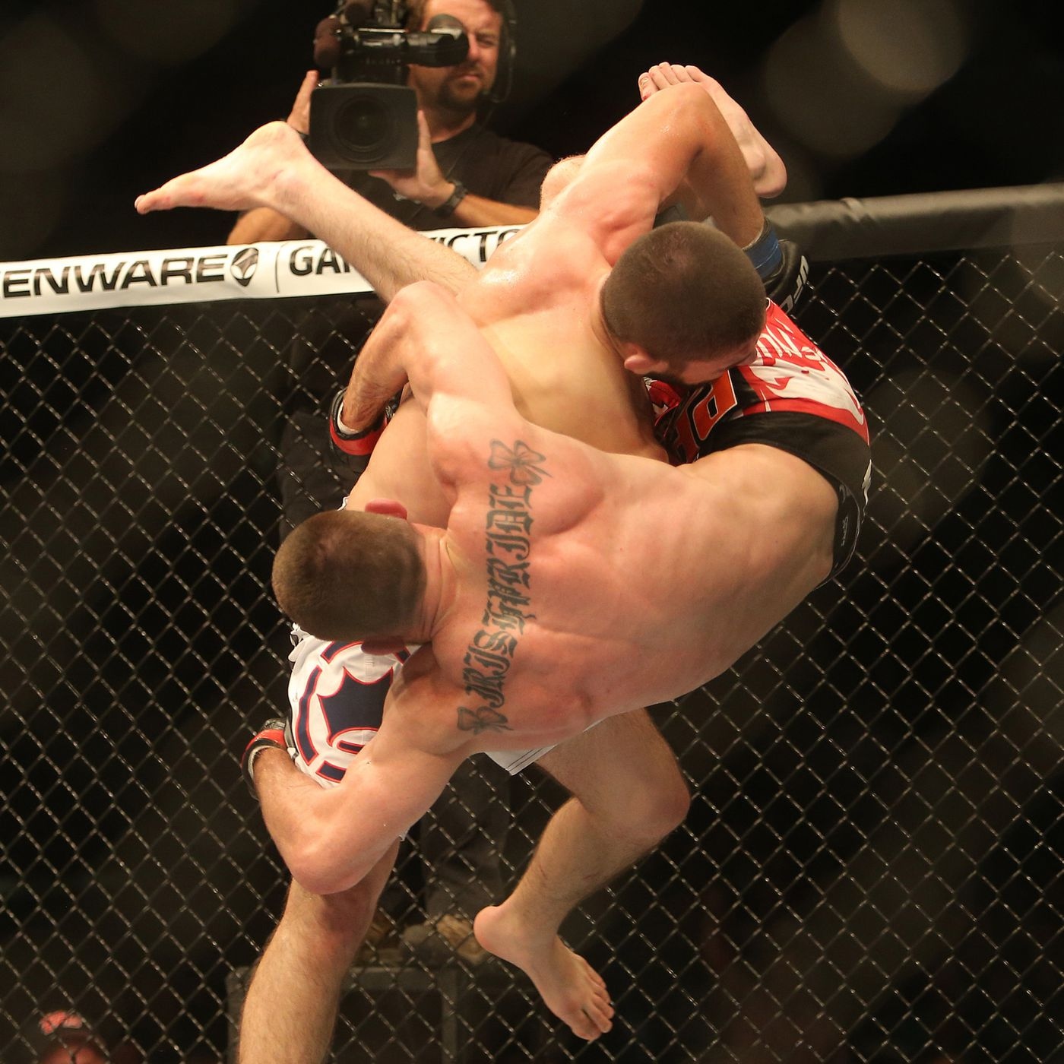
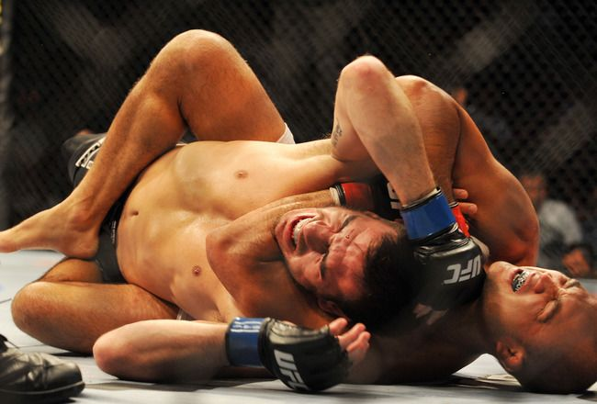
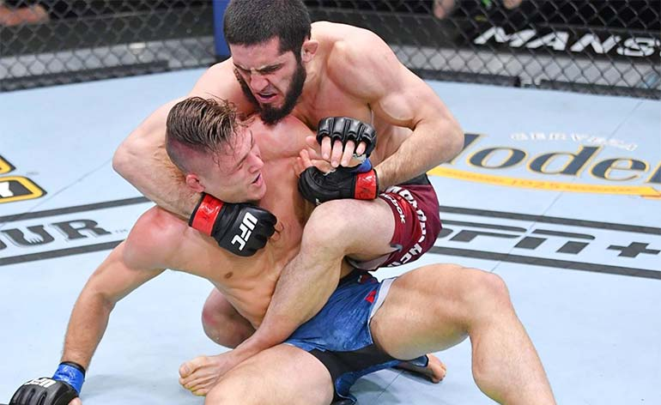
Background A quick introduction on MMA
Multi-disciplinary fighting styles:
Boxing
Kickboxing
Muay Thai
Taekwondo
Karate
Brazilian Jiu-Jitsu (BJJ)
Wrestling
Sambo

Slide 5
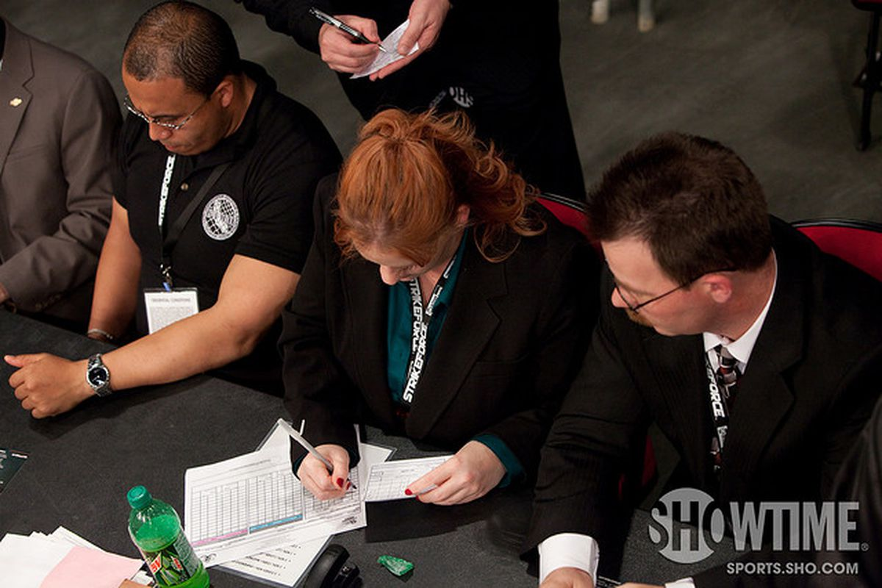
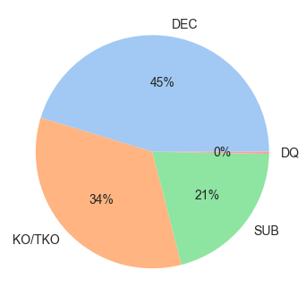
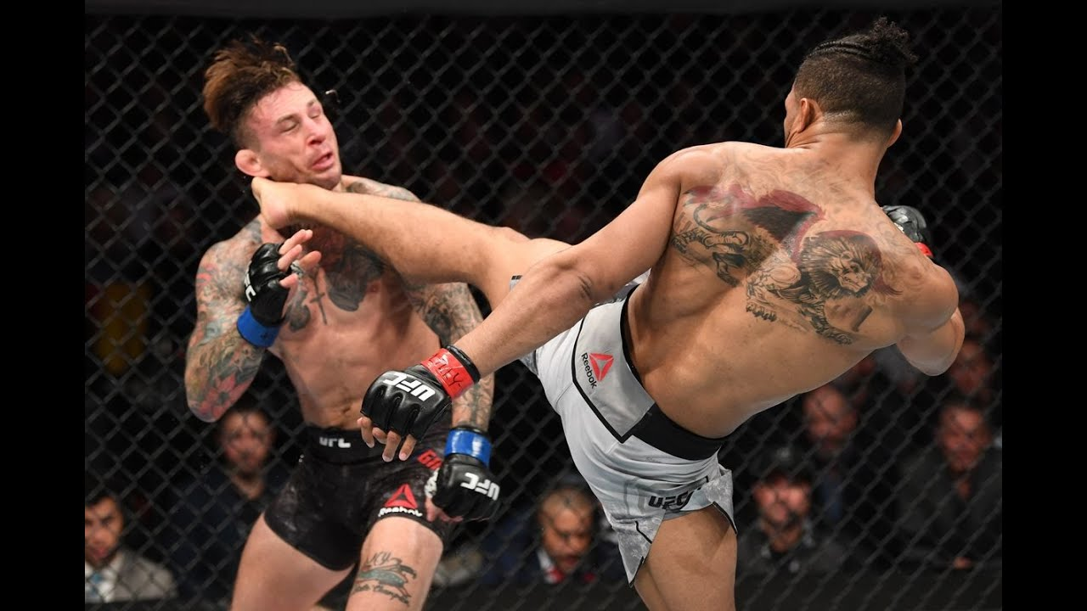
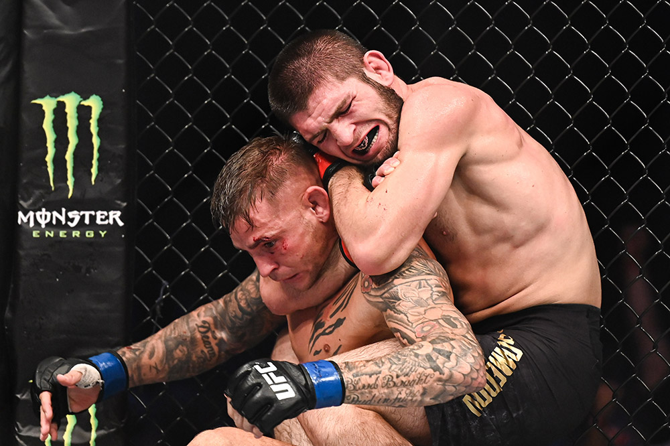
Background A quick introduction on MMA
3 methods for fights to end:
Decision
KO/TKO
Submission
45% of fights are decided by judges
Notes:
Kicks are very well utilized in MMA
Some EDA info on kicks and what type of kicks are best at winning or KO power.
79% of fights end in either DEC or KO/TKO, which are mostly dependent on striking abilities.
Proven by the UFC event over the past weekend, where in 4 out of the 5 main fights, the winner had higher significant strikes.
As such, focus of this project will be on analysing strikes.

Slide 6
How are fights scored?
Effective striking
Effective grappling
Effective aggressiveness
Control of fighting area
Strikes attempted
Significant strikes landed
Striking accuracy
Notes:
So there are 4 main criteria for judges to score, but they all seem subjective.
However there is 1 that stands out as being the most objective and that is effective striking.
So what entails effective striking?
By metrics such as these. However these are counted manually in UFC through the rounds, and it may not be validated in time to assist the judges in scoring the fights.
Again. MOTIVATION: for the future of MMA to include a CV tool that is better able to calculate these numbers.

Slide 7
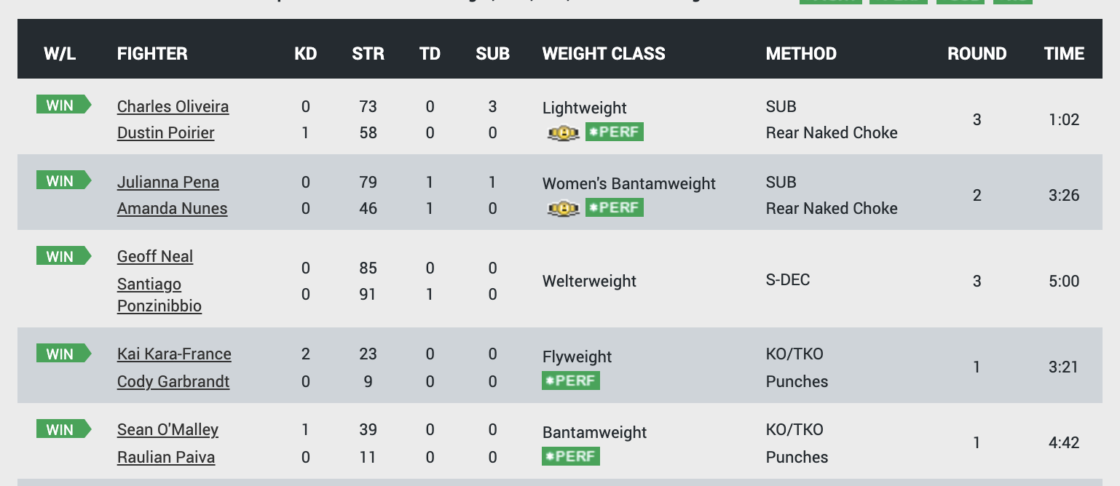
Notes:
Interestingly, the only fight that went the fuLl distance and was decided by judges was the only fight where the winner had a lower striking number than the loser. Of course MMA is not just about striking, the quality of strike also matters and that is where the judges are required. However, again this shows potential for the use of CV.

Slide 8
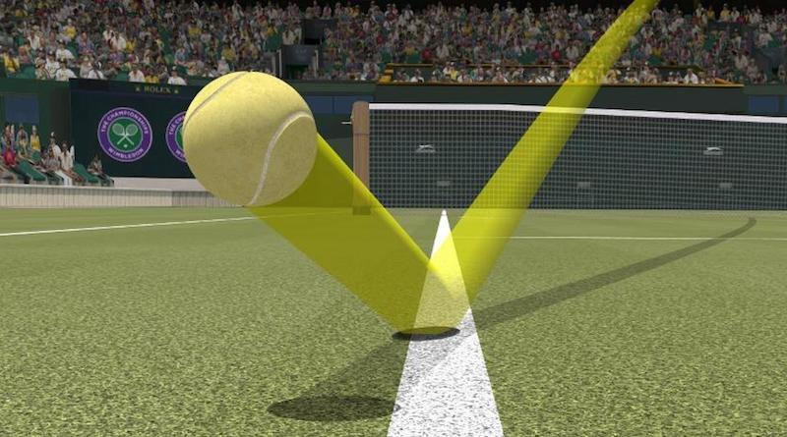
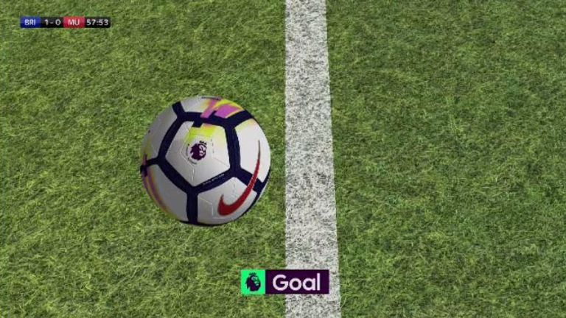
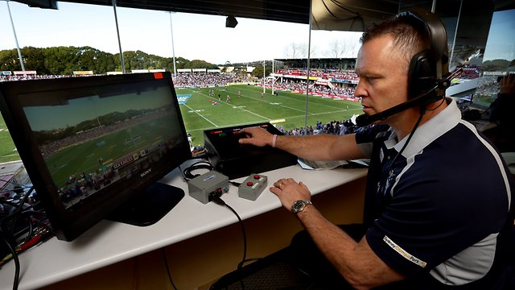
Problem Statement
Problem: Judging the winner of a fight can be tricky and even subjective at times.
Objective: Assist judges in making their decision based on striking numbers.
Solution: Computer vision tool to assist judges in scoring rounds and reduce subjectivity
Tennis – Hawk Eye
Football – Goal Line Technology
Rugby – Video Refereeing
Notes:
Effective striking and grappling. Determined by how many legal strikes had been landed, how many takedowns and reversals are executed; submission attempts and position advancements are also taken into consideration.
Effective aggressiveness. Chasing down the opponent with the intention of attacking (p.e., throw a shot, shot for a take-down, …). Moving forward actively (wanting to finish a fight), not passively.
Control of the fighting area. The fighter that is controlling the center of the cage and pushing the opponent outwards (against the cage). The fighter that is dictating the pace and rhythm of the fight and choosing where the fight takes place.
WHY STRIKES?
All fights start on the the feet. As such, strikers will always have the initial advantage over grapplers every round.
MMA fights are fast paced and some of the moves may happen too fast for the human eye. As such, judging a fight may be challenging and subjective.
How are fights scored?
Effective striking
Effective grappling
Effective aggressiveness
Control of fighting area
Objective: To create a computer vision tool to assist judges in scoring round and reduce subjectivity in judging fights.
In the form of a strike counter to measure the “effective striking” or ”aggressiveness” of a fighter, that can assist the judges in scoring each round of a fight.
Other potential use: To expand the tool to measure ‘ring control’ and even takedown.
WHY STRIKES?
All fights start on the the feet. As such, strikers will always have the initial advantage over grapplers every round.

Slide 9
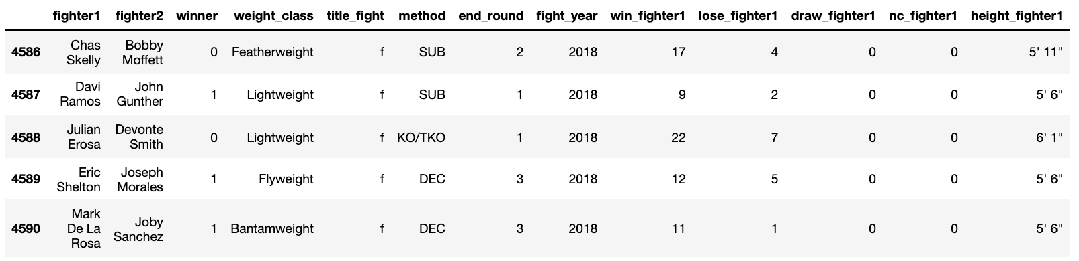
Data Cleaning (Feature Selection)
Fighter-specific features
Age, Height, Reach, Stance, Weight Class
Fight-related features
Strikes: Landed, Absorbed, Defended, Accuracy
Takedown: Landed, Defended, Accuracy
Submission: Attempted
Other features
Round end, Method, Title Fight
Notes:
Features that are not known before a fight are removed, so that can predict future fights.
E.g. round match ended, the method that the fight as won by

Slide 10
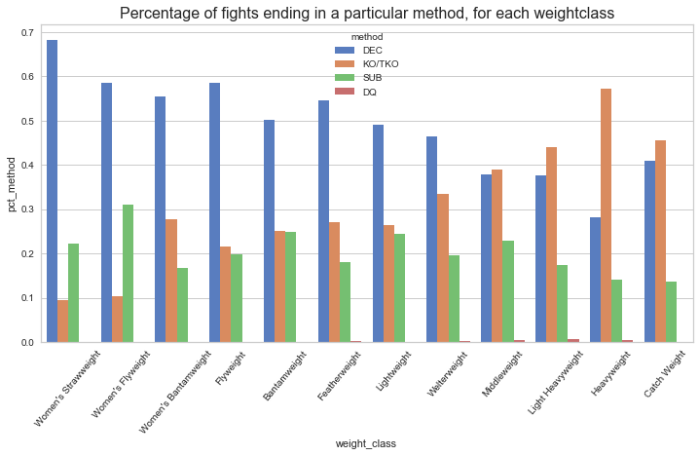
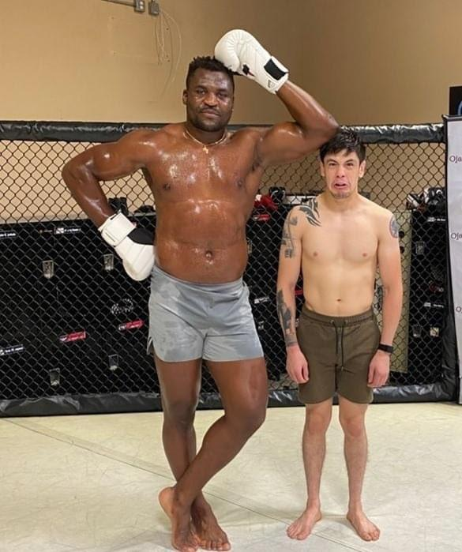
EDA
As weight class increases, higher percentage of fights end in KO/TKO
Notes:
As weibht class increase ,higher percentage of fignts end in KO/TKO.
So as you can imagine, the heavyweight fighter on the left would possess greater striking power than the flyweight fighter on the right and therefore have higher chance to Knockout his opponent.
While the lighter fighter may want to utilize his grappling, etc
So to analyse fights, I gathered a dataset of 4000+ fights in the UFC that have various features of a fighter and the target variable whether they win or lose a fight.

Slide 11
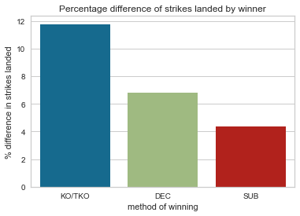
EDA
Fighters that win by KO/TKO land more strikes against their opponents that those that win by SUBS

Slide 12

MMA Fight Predictor

Slide 13
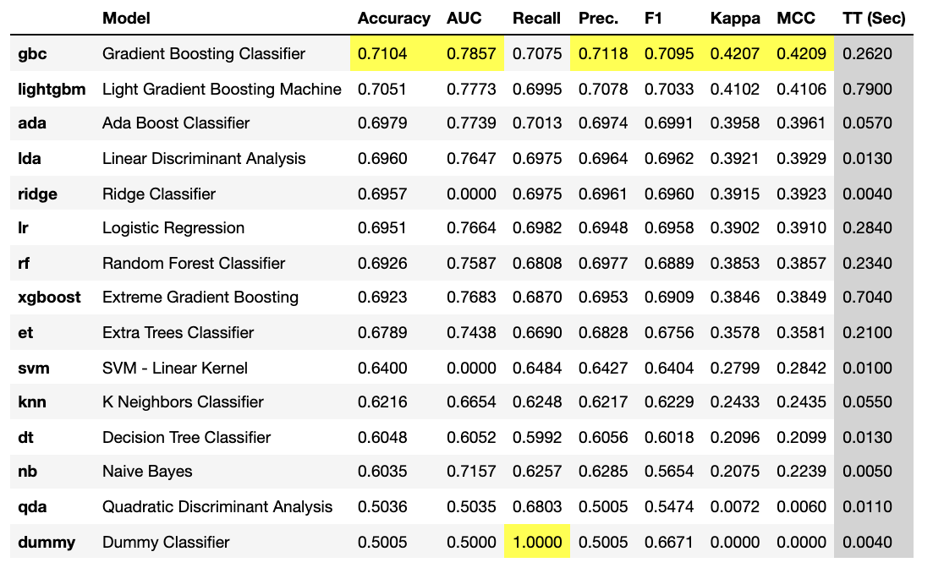
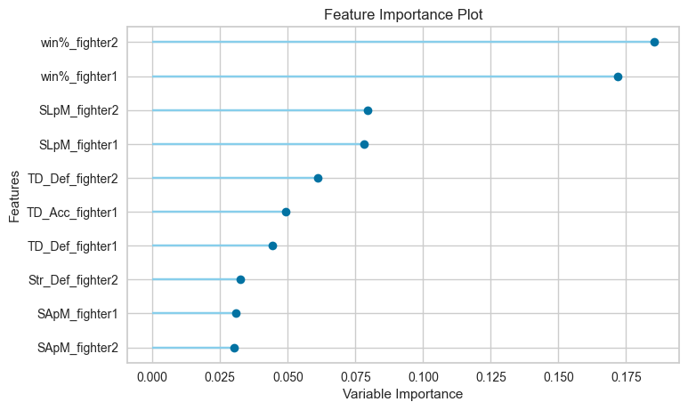
Modelling
Accuracy on Test Set: 78%
SLpM: Strikes Landed per Minute
Str_Def : Strikes Defence
SApM: Strikes Absorbed per Minute
Notes:
Gradient Boosting Classifier was selected based on higher scores overall across most classification metrics.

Slide 14
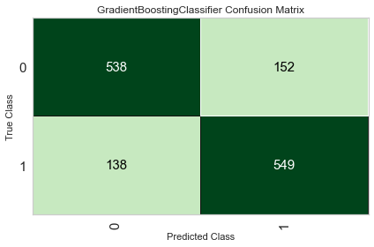

Slide 15
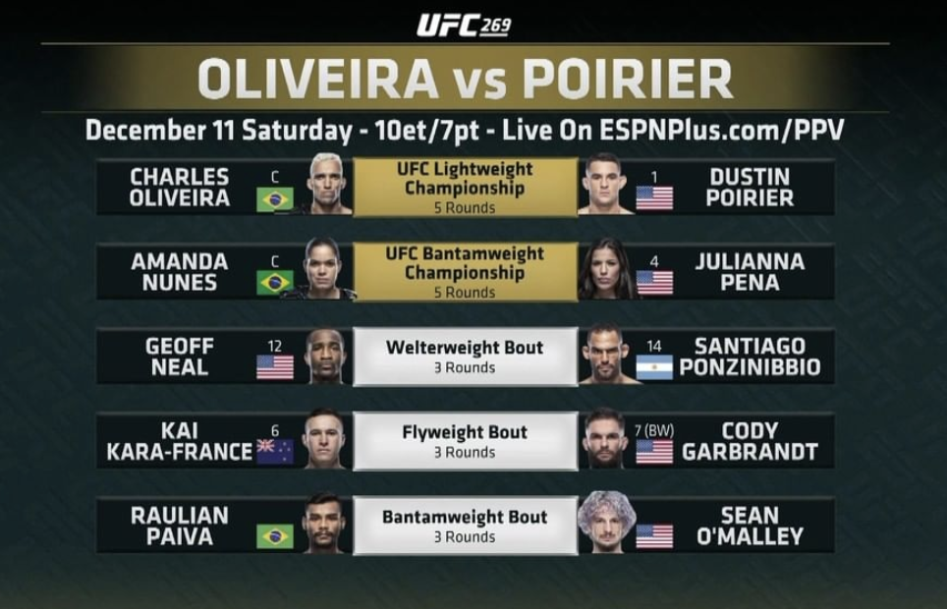


Prediction
Winner
Winner
Winner
Winner
Winner

Slide 16
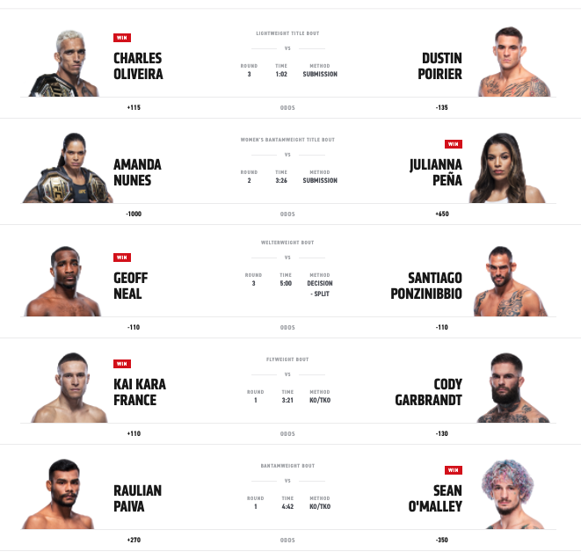
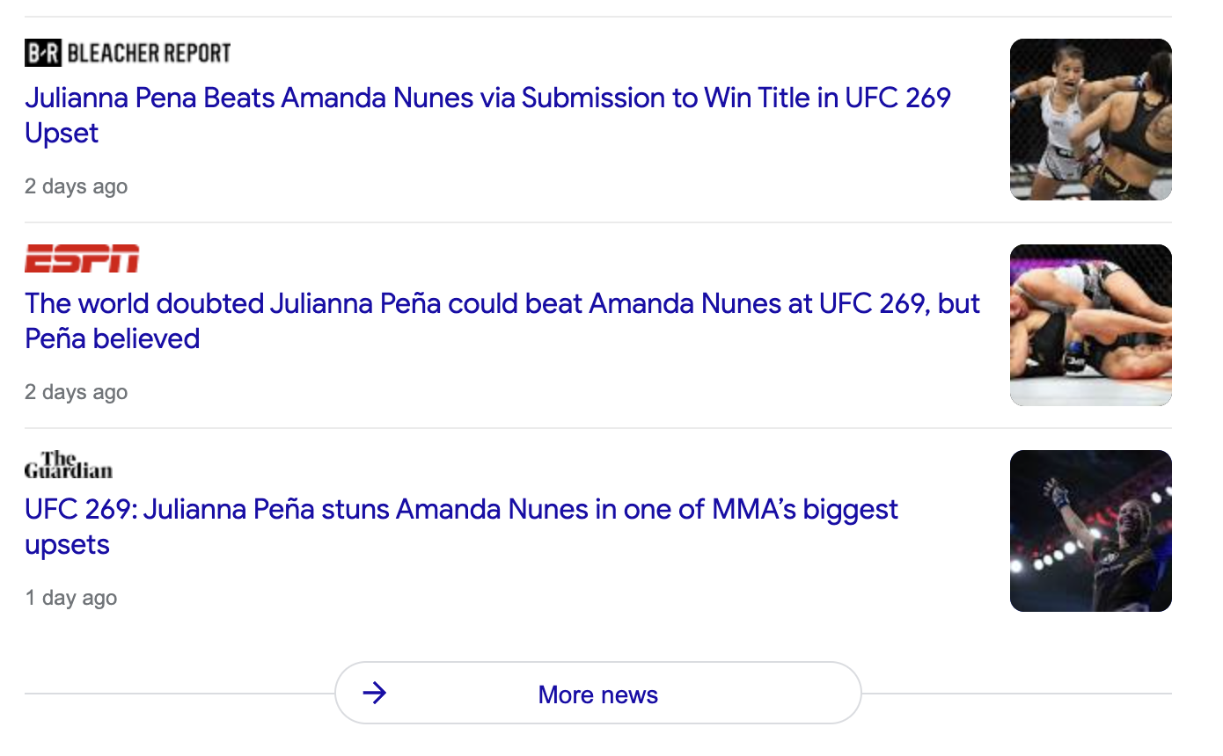
Prediction
Predicted
winner
(83%)
Predicted
winner
(80%)
Predicted
winner
(80%)
Predicted
winner
(60%)
Predicted
winner
(65%)
Notes:
One fight that the model predicted wrongly in particular is the co-main event. It was considered a huge upset, some even calling it the biggest upset in MMA history. This goes to show that the sport of MMA is so unpredictable, that one move can turn the fight around.
As you can see the news all over was talking about how this fight was a huge upset. You can probably do an NLP on this , but yea just goes to show how MMA fights can get unpredictable at times, such is the nature of the sport.

Slide 17
Computer Vision Analysis of Strikes

Slide 18
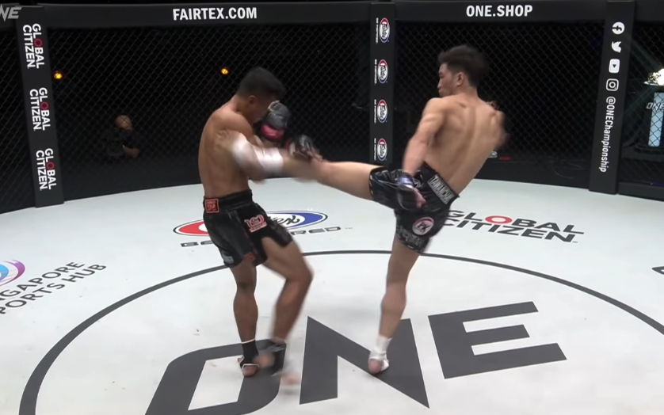
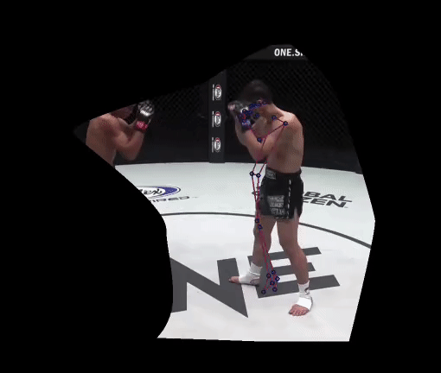
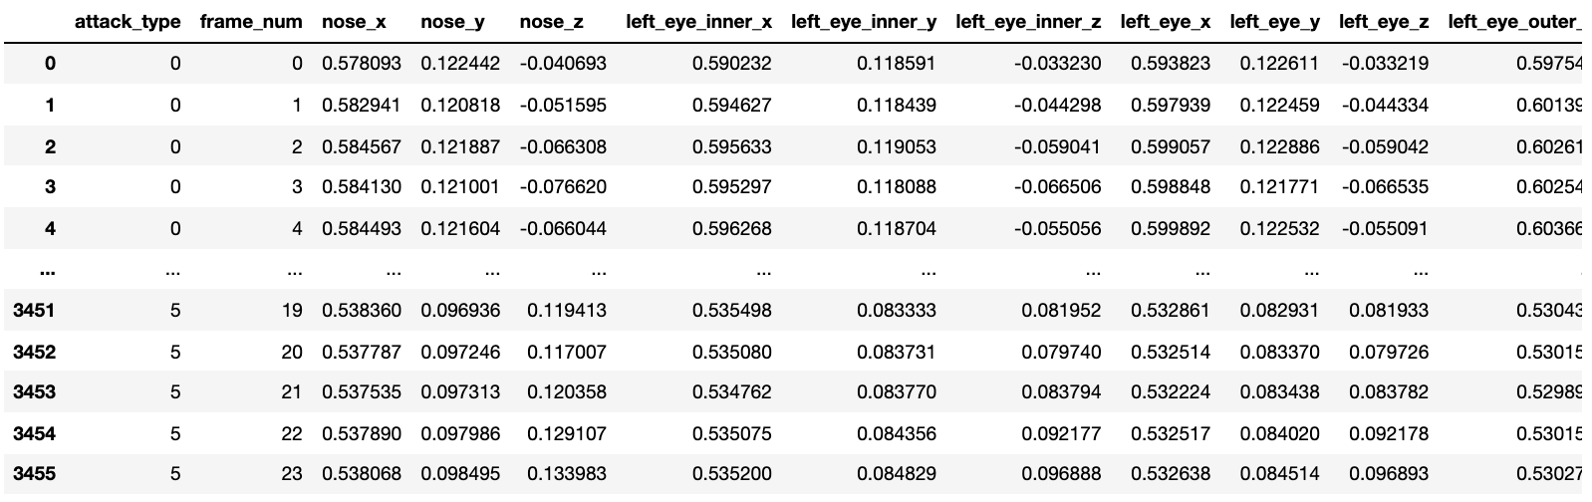




Data Collection
Video footage of MMA fights from online sources
Crop out only the relevant fighter and apply pose estimation
Extract pose estimation keypoints into dataframe

Slide 19
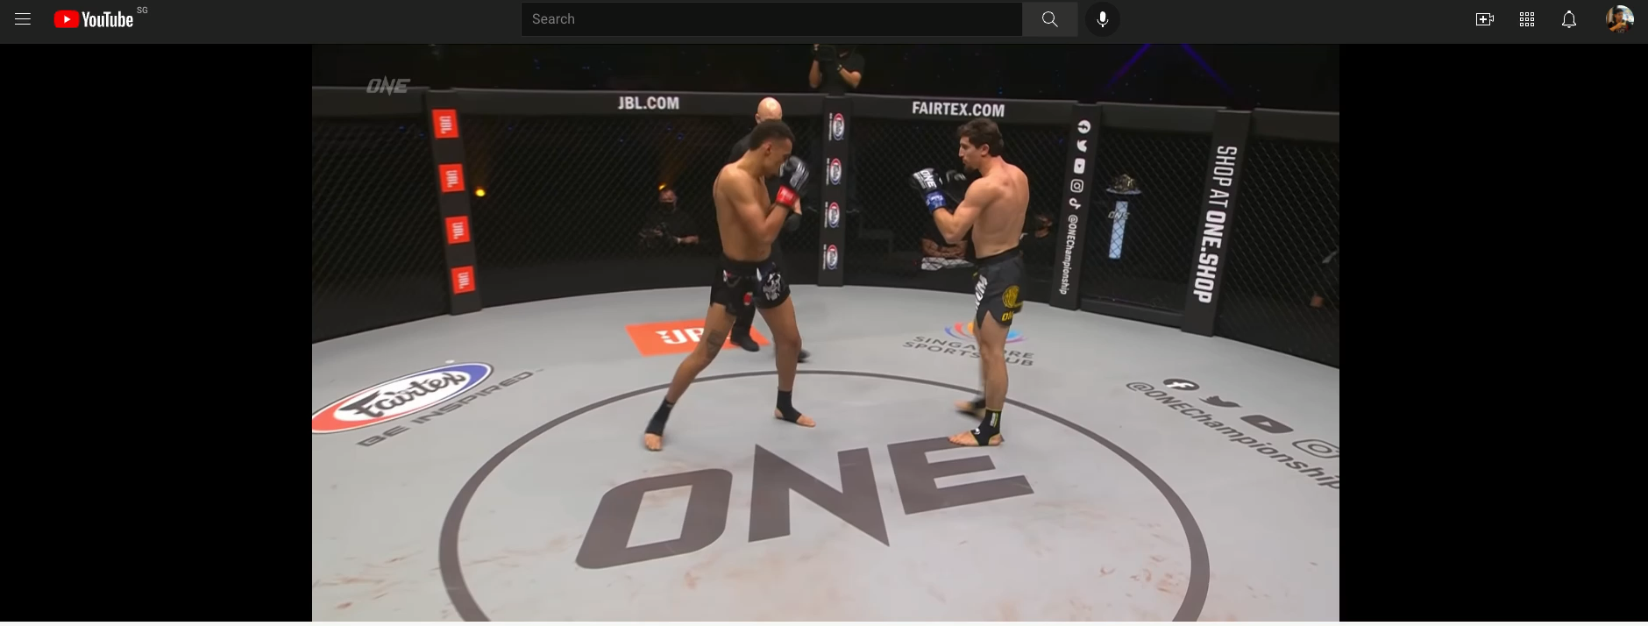
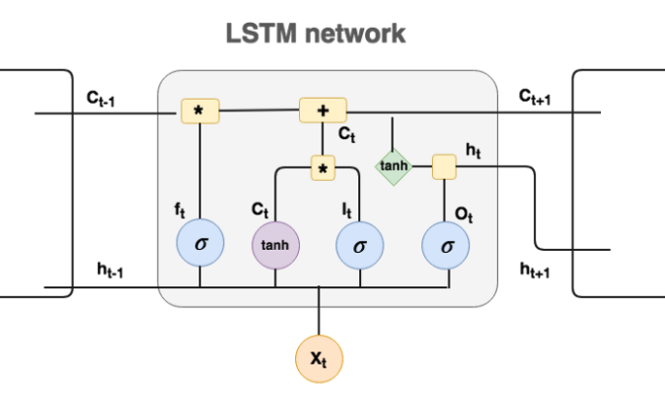
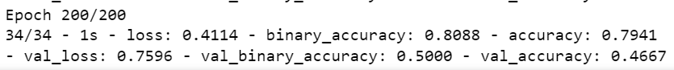
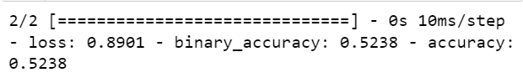
Modelling (LSTM)
Train set
Test set

Slide 20
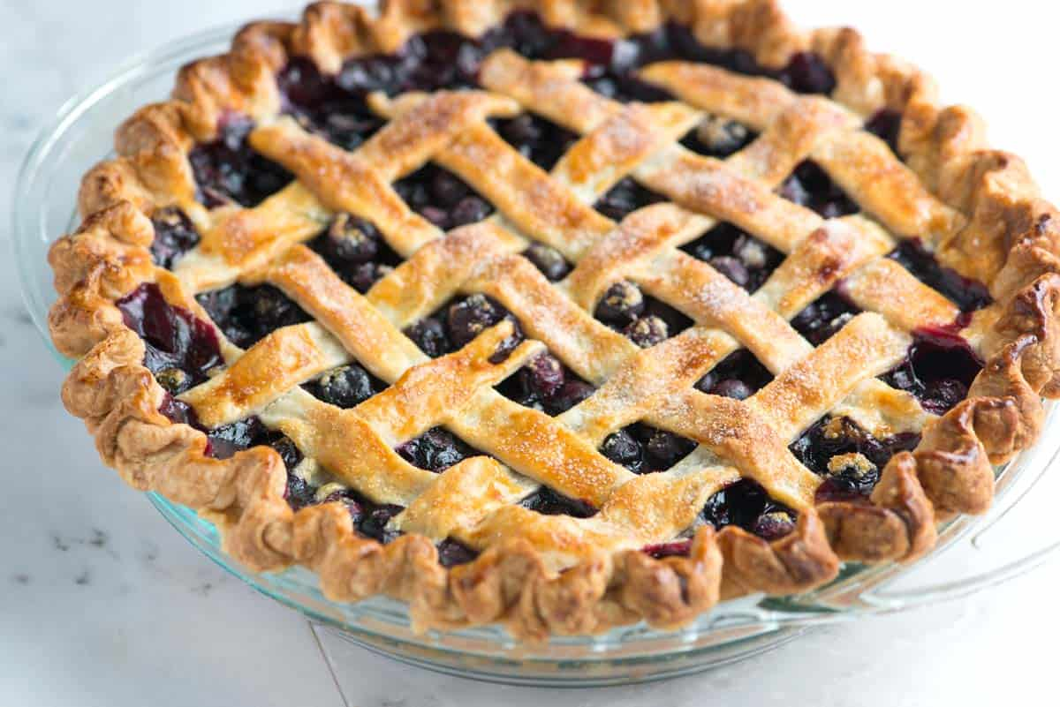
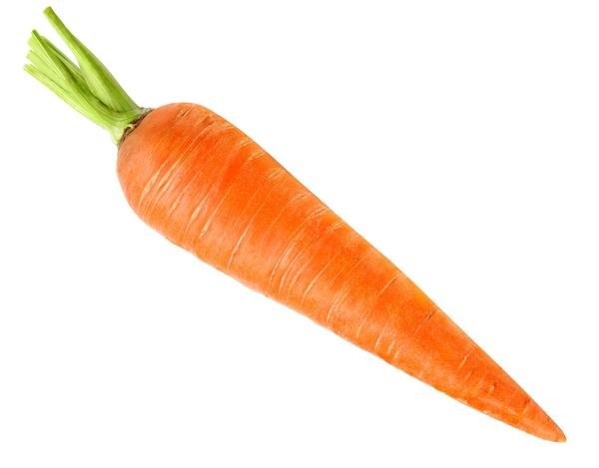
Extra Trees Classifier
Accuracy = 90%

Slide 21

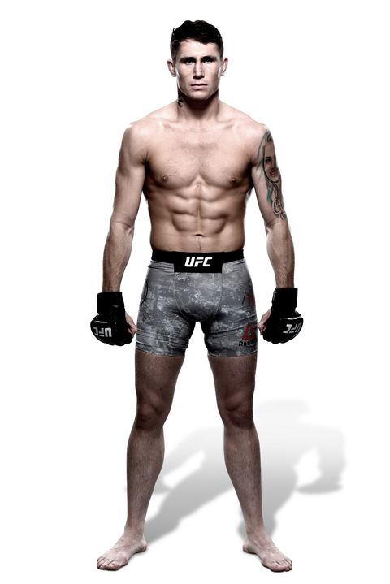
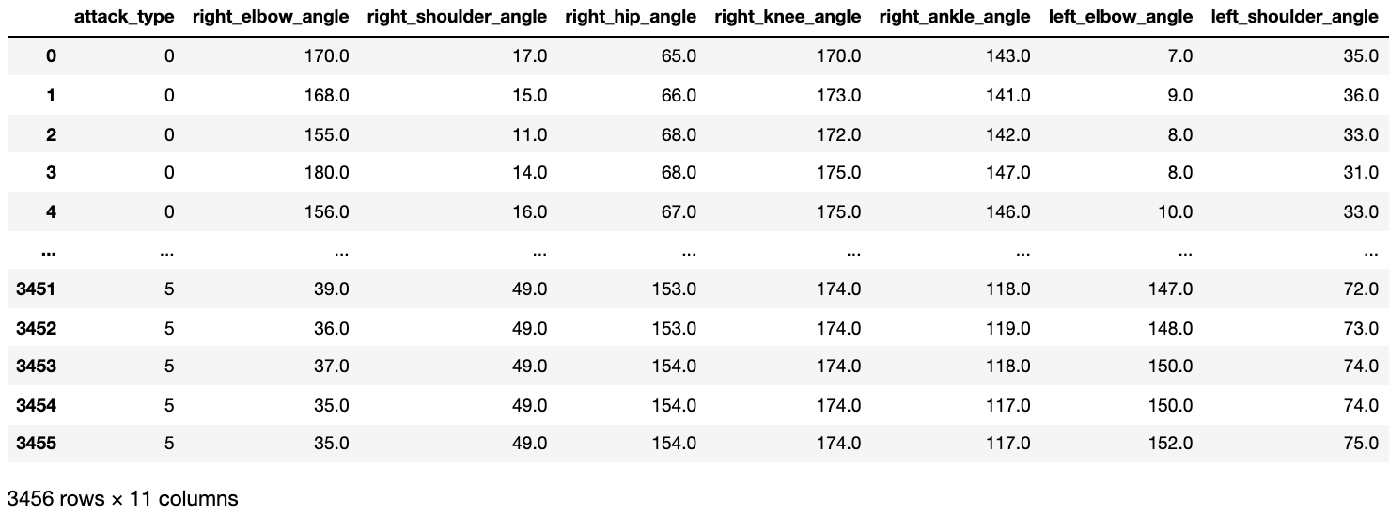
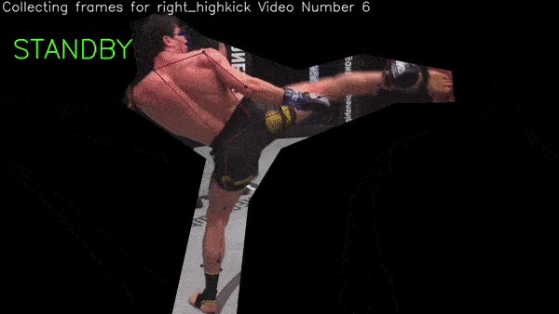
Data Preprocessing
Remove frames before a strike.
10 joints angles kept, other keypoints removed.
Only still images of each strike type were used.
Total of 6 different strikes
Notes:
Keypoints were dropped, as it generated too many features, potentially overfitting the model.
10 joints angles were feature engineered.
Only still images of each strike type were used.
Video footage gave too much noise.
For the exact same image, if we apply pose estimation, it doesn’t capture the same points, this is sort of the randomness of it. And so, I decided to apply 24 frames for each image. So this would prevent overfitting of the model.

Slide 22
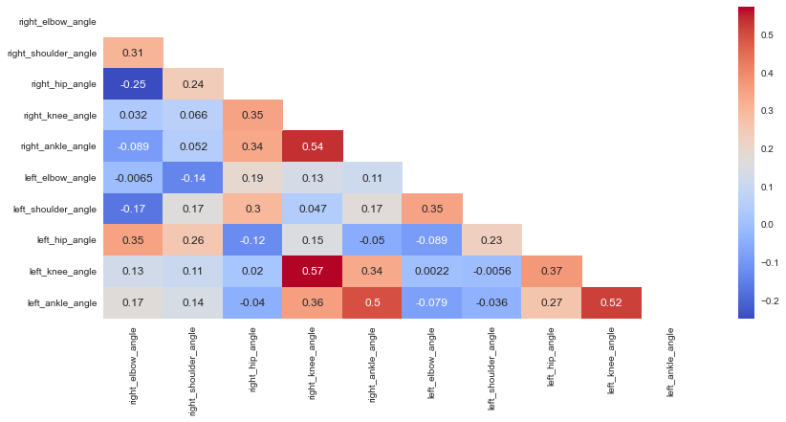
EDA

Slide 23
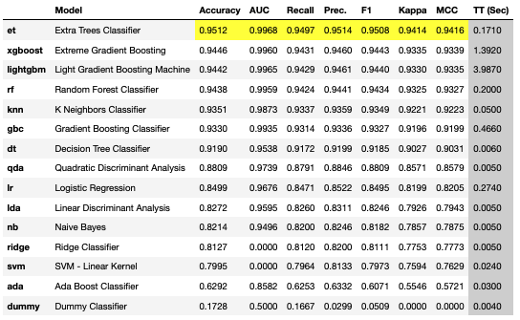
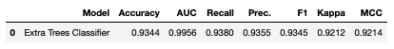
Modelling
Train set
Test set

Slide 24
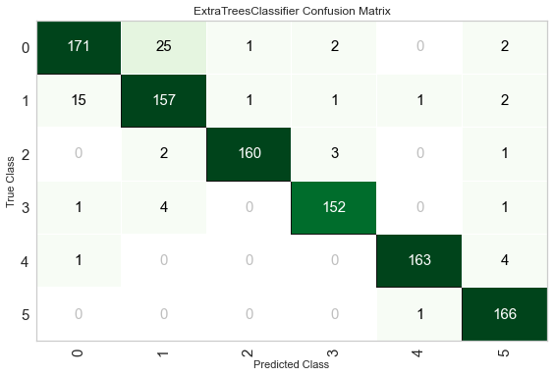
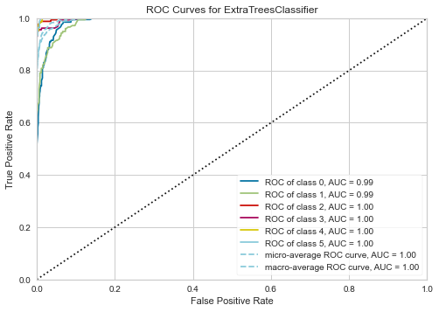
Model Results

Slide 25
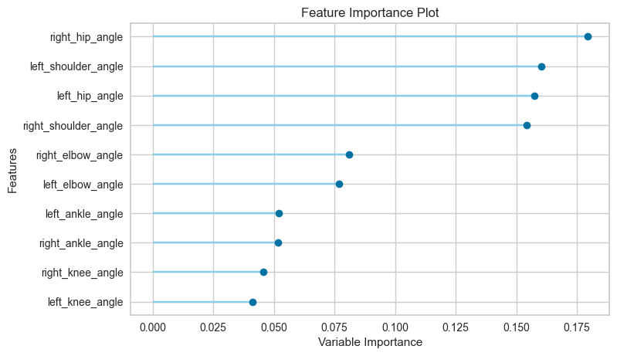
Feature Importance

Slide 26
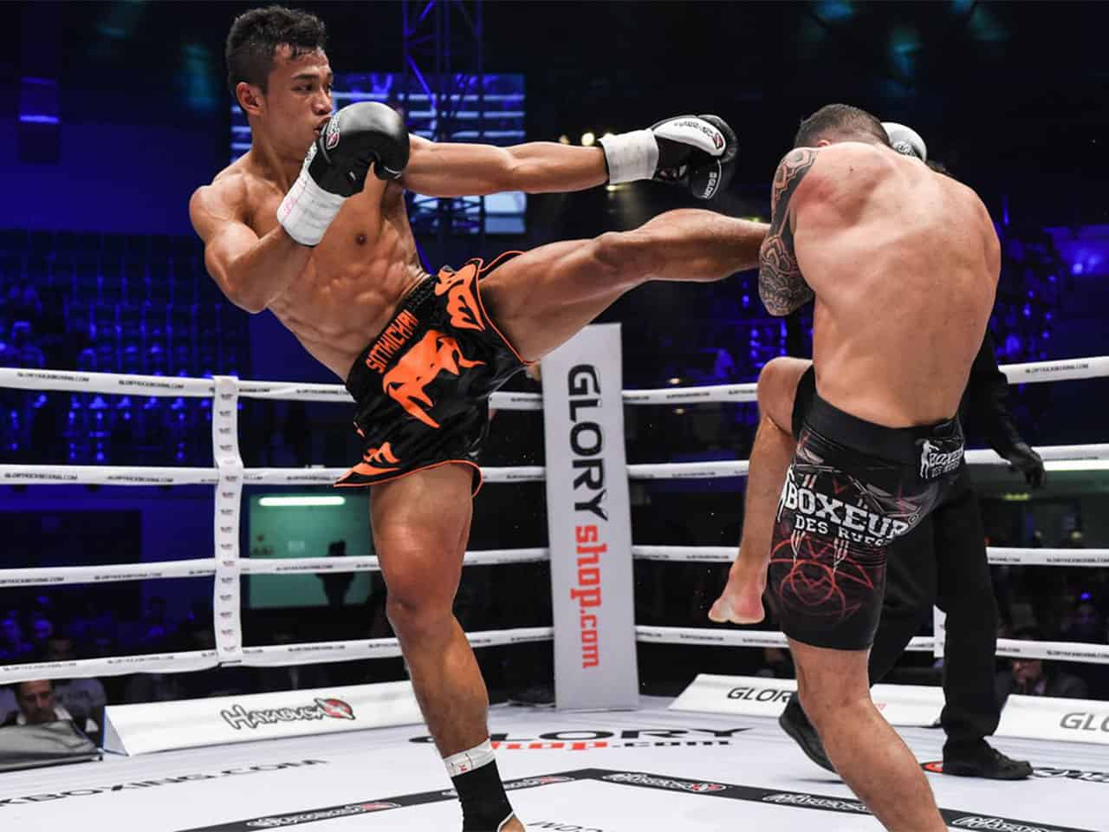
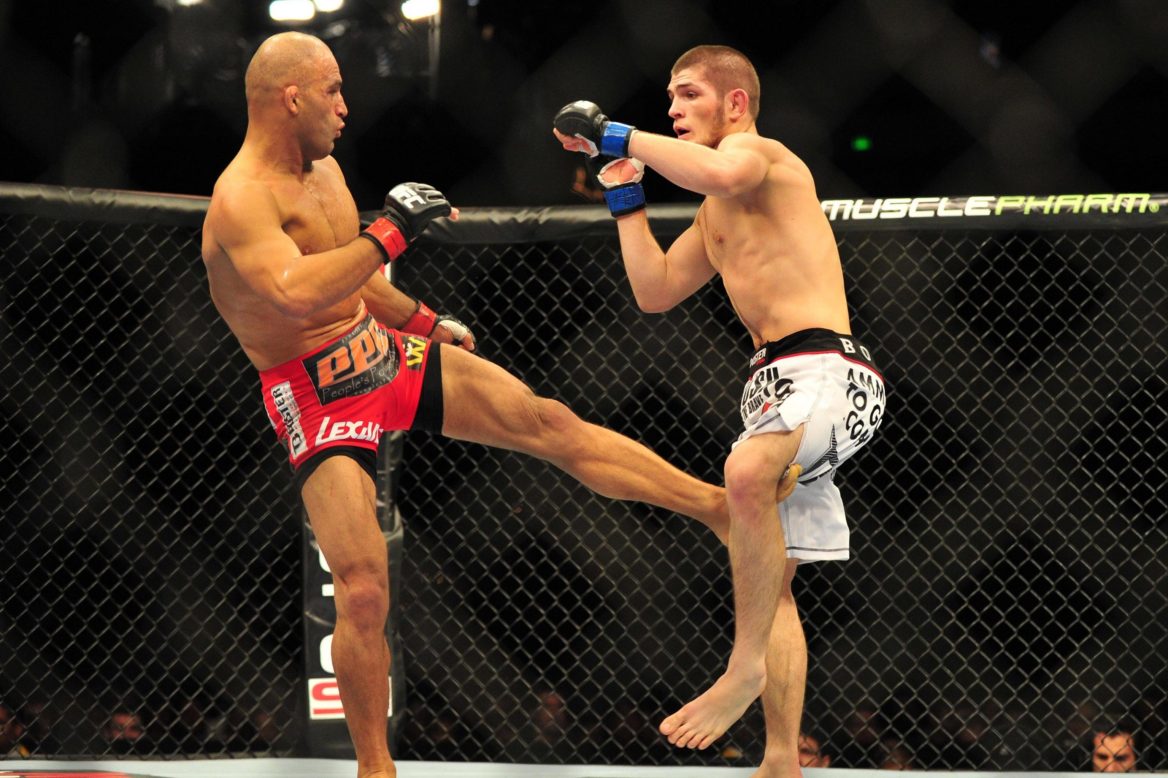
Visualization of shoulder and hip angles
Left high kick
Left low kick

Slide 27
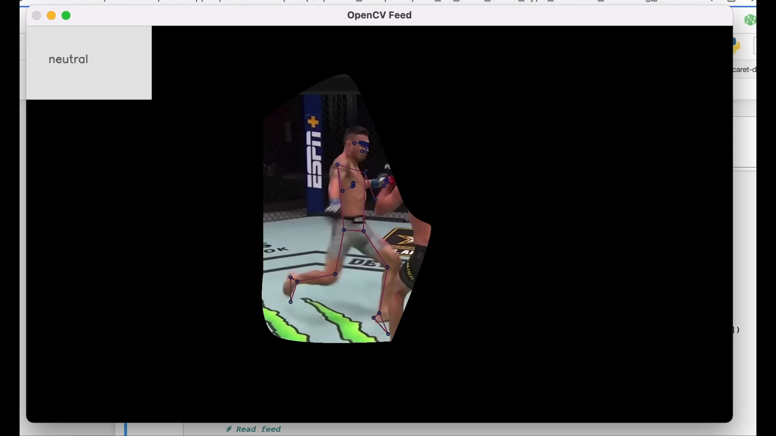
Potential use

Slide 28
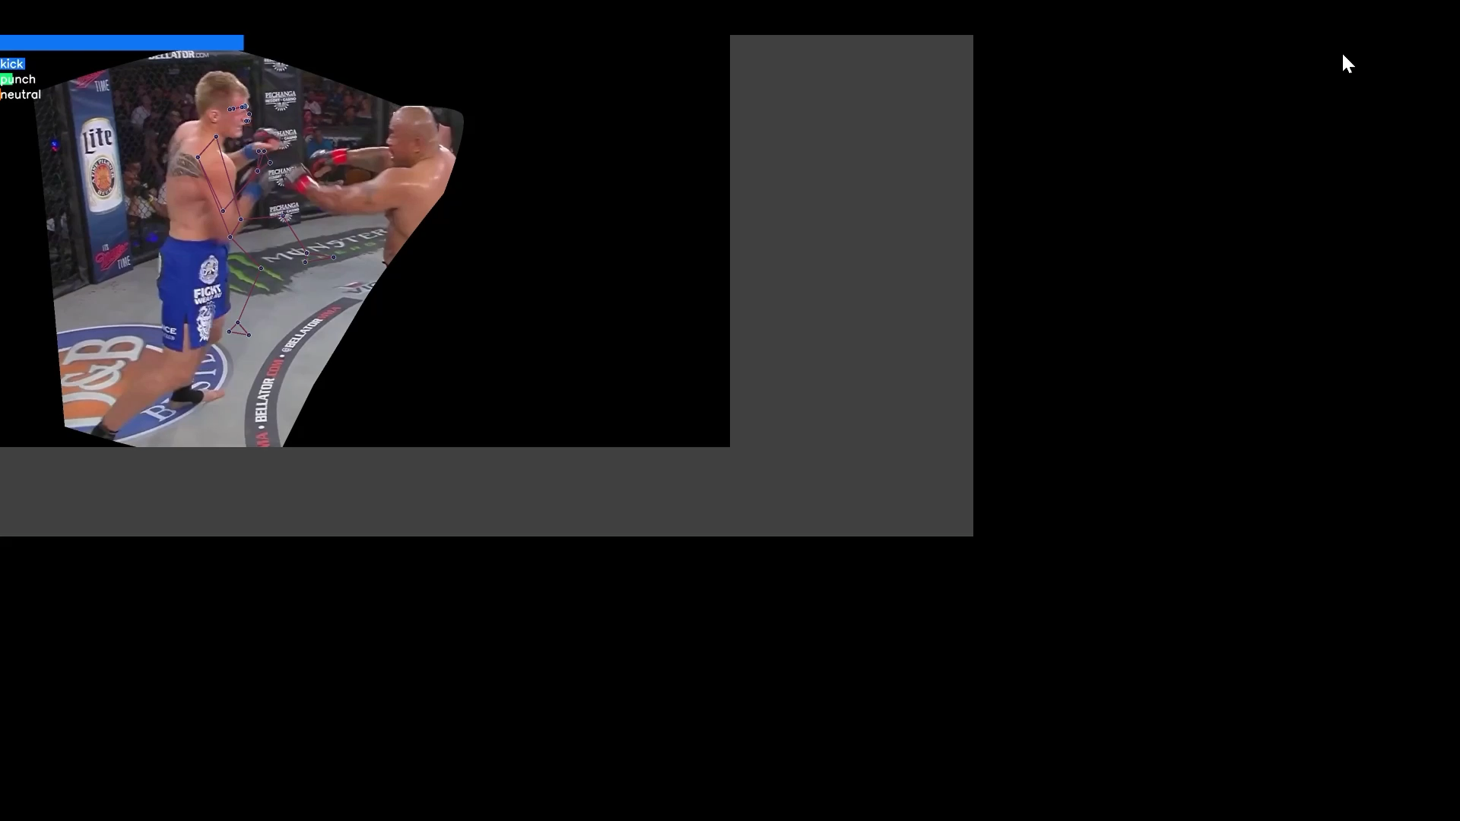
Potential use

Slide 29

Challenges faced / Limitations
No consistent camera angle.
Unable to ‘fix’ the detection to one person.
Editing each video is not feasible.
Notes:
Similar to FIFA’s semi-automated Offside Deicisions, this tool can be of assistance when the judges are scoring decisions between rounds based on strikes.

Slide 30

Future Improvements
To include an ‘impact’ component
Minor, normal, significant
Measuring other aspects
Ring control, aggressiveness
Potential use to evaluate safety of fighter
Facial recognition.
Detect pain or lack of consciousness.
Notes:
Lots of fighters telegraph before a kick/punch to load up on the power. With better, more accurate Pose Estimation, we could get into the grainier details and potentially predict a kick/punch in-fight.
E.g. before a head kick, fighters tend to bring up their arms up high and chin up. Unfortunately, opencv and mediapipe unable to track small motions like this and the video quality is too poor to track.
Potential use to evaluate safety of fighters before its too late, perhaps by looking at facial recognition tools using CV.
To use pose estimation for predicting moves of an opponent.
To include an ‘impact component’
Potential use to evaluate safety of fighters before its too late, perhaps by using facial recognition tools with Neural Network to detect pain or lack of consciousness.

Slide 31
Conclusion
Striking is a major aspect of MMA fights.
45% of fights are decided by judges.
CV tool proposed to classify different types of strikes.
Accuracy = 93%
F1 = 93%
Assist MMA judges in scoring each round.

Slide 32


Slide 33
Thank yOU

Slide 34
Problem Statement What problem are you trying to solve? What larger issues do the problem address? | Outcomes/predictions What predictions are you trying to make? Identify predictors (X variables) and target variables (y) | Data Acquisition Where are you sourcing your data from? Is there enough data? Can we work with it?
Modeling What models are appropriate given the outcomes? | Model Evaluation How can you evaluate your models performance? | Data Preparation What data prep is required to achieve desired outcome?

Slide 35

Limitations of multiperson pose estimation
Cons
Unable to distinguish between 2 players that are closeby
Not able to detect kicker

Slide 36
Classical vs Deep Learning Human Pose Estimation (HPE)
Classical:
Swallow machine learning algo
Deep Learning:
CNN (Convolutional NN) works best for HPE
DeepPose
OpenPose (VGG-19) ➔ bottom up approach.
DNN (Deep NN)
Struggles for multi-human ==> too computationally complex
Include distance between 2 man or pose for potential takedown or not. (multiperson)
Angle calculation rather than x,y – coords

Slide 37
Ghost Slide
Problem Statement :
To produce a CV method that quantitatively evaluates MMA strikes (particularly kicks).
To differentiate between low, medium, high kicks and test it’s strength in winning the bout
Pattern recognition?
Does more pressure gives you higher win prob?
MMA stance detection?
Calculate distance between fighters and suggest on whether fighter is within striking zone or takedown zone or
Detect pain on the face (using mediapipe holistic)
Find relation to striking vs win %
Use opencv to improve striking skills for better win %

Slide 38
Modeling
Predicting kicks to KO / win ratio
Predicting angle of kicks to efficacy?
Removing visibility improves prediction on unseen data
To add neutral pose to avoid ‘noise’
Increase epoch
Moving average was done
Create a logic such that the pose estimation position doesn’t jump between fighters

Slide 39
Methods
CNN + LSTM
https://machinelearningmastery.com/cnn-long-short-term-memory-networks/
https://keras.io/examples/vision/conv_lstm/
Using arrays from convolution filter
Mediapipe pose + LSTM
Using arrays from angles and coordinates
Applying moving average to smoothen out

Slide 40
Flow
Get videos of 30fps and extract the arrays using code by Renotte
Try without masking first
Extract angles from these videos and split between 3 types of kicks:
Head kick
Body kick
Low kick
Apply the Pose Estimations and extract the angles
Either using Mediapipe
Extract each frame
Apply data aug
LSTM trained on each frames
Or tf multiperson
Apply the array angles to LSTM model to detect movement
Split train/test set

Slide 41

Masking pics

Slide 42
Limitations
Only able to use youtube videos
No dedicated view from one angle
Pose estimations kept jumping around
As a result, not able to fix the object detection to the person as camera angles kept changing throughout the videos

Slide 43
To Do
10 Dec: add 3rd or 4th class
Further refine data processing
Conduct EDA on angles
Test with video of 1s before kick/punch
Try put condition for pose estimation to remain on one person

